Slide 1

Identifying Muscle Dysmorphia
Alex Butera, Ryan Canfield, Patrick Norcross
Data Science Capstone - Fall ‘23

Slide 2


Introduction
Data Collection
AGENDA
Methods and Results
Conclusion

Slide 3


Introduction
Early Setbacks
Background Information
Objectives
Why is This Important

Slide 4

Early Setbacks
Our initial dataset pertained to HIV patients and was being provided to us by Johns Hopkins.
Due to unforeseen circumstances with the data being able to be transferred to us, we could not get it until Christmas at the earliest.
This was very unexpected and caused us to lose nearly 10 weeks of time that we could’ve spent analyzing another data set.

Slide 5
Background Information
Muscle dysmorphia is a psychological condition where individuals feel distress or dissatisfaction with the size, shape, or appearance of their muscles. It's often associated with body image issues and a perceived discrepancy between one's actual muscle mass and the desired or expected level of muscularity.
Overall Goal: To find patterns and correlations between factors that can tell us if an individual suffers from muscle dysmorphia.

Slide 6
Objectives
Objective 1:
Characterize resistance training behavior, and mental health, in a sample of men with symptoms of muscle dysmorphia.
Objective 2:
Explore whether a worse mental health, including symptoms of muscle dysmorphia, are associated with more frequent and intense resistance training behaviors.
Objective 3:
Explore any associations between mental health and substance and supplement use.

Slide 7
Why is This Important
Helps us Understand Mental Health - Can have a profound impact on an individual's mental well-being, leading to distress, anxiety, and even depression.
Prevention and Education - Can raise awareness and educate people about the factors that contribute to body dissatisfaction and unhealthy behaviors related to body image.
Impact on Physical Health - Can lead to extreme behaviors like excessive exercise or steroid use, which can have detrimental effects on physical health.
Support and Treatment - Research helps in developing better support systems and treatment strategies for individuals experiencing muscle dysphoria. (Ex: therapy & support groups)
Social and Cultural Implications - Muscle dysphoria sheds light on societal and cultural influences on body image standards, particularly those related to muscularity.

Slide 8
Data Collection
Collection
Description
Preprocessing
Sample Demographics

Slide 9
Data Collection
The dataset was given to us in two parts by our client Dr. SantaBarbara.
It was collected by him during his masters and doctoral dissertations.
Both datasets were in .SAV files, which we converted and combined into a .CSV file.
Notes:
Explain each data dtype explain rows and columns

Slide 10
Data Description
Resistance training Behaviors
Perceived Intensity
Chest, Arms, Legs, and Biceps strength
Days per week
Minutes per session
Substance and Supplement Use
Substances: Marijuana, Hallucinogenic, Steroids, Cigarettes, etc.
Supplements: Protein, Creatine. etc.
Notes:
Explain each data dtype explain rows and columns

Slide 11
Data Description Cont.
Mental Health Indices - Various mental health survey questionnaires
CESD - Depression, Clinical cutoff of 10 and above considered “depressed”
STAI - Anxiety, Clinical cutoff of 40 and above considered “very anxious”
MDI - Muscle Dysmorphia Inventory
RS - Emotions pertaining to gaining/losing weight and nutrition habits
BDS - Bodybuilding Dependence, emotions pertaining to workout habits
SPAS - Social Physique Anxiety
AUDIT - Behavior and relationship with alcohol.
Notes:
Explain each data dtype explain rows and columns

Slide 12
Preprocessing
Aligned the data sets.
Removed underscores, and spaces, and uppercased all characters.
Renamed remaining variables that didn’t match the previous conditions.
Dropped columns that did not match.
Double checked values that didn’t portray information in the same way.
Removed all rows that had participants who did not have muscle dysmorphia.
Notes:
This meant that each variable name was the same, data type and ranges of values were the same, and each variable stood for the same thing.
This allowed variables like “su_9” in one dataset to be paired with “SU9”
that could not be automated. For example, in one dataset there were “height” and “weight” and in the other, we had to rename “ht20” to “height” and “lbs” to “weight”.
The dataset used for the doctoral dissertation was more complex than the other, so we took out multiple columns from that dataset. At this point, after accounting for hundreds of columns, the two datasets were combined.
An example of this Income variable. in one dataset was on a scale and in the other it was continuous.
Client wishes not our target large portions of missing data.

Slide 13
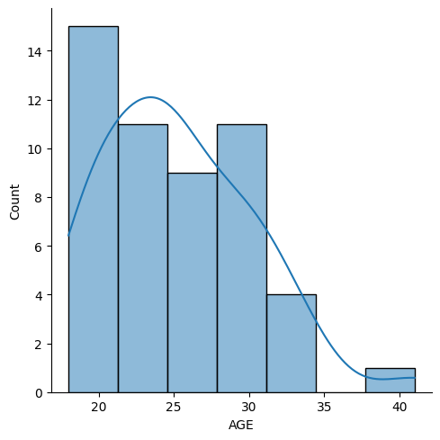
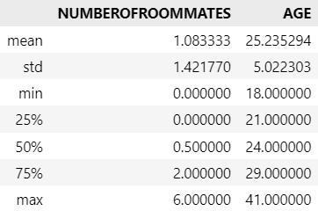
Sample population Demographics
General summary statistics that give us a good idea of who these people are and their living conditions:

Slide 14
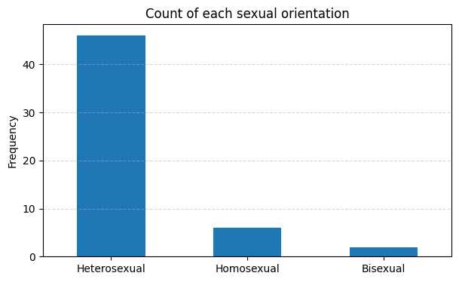
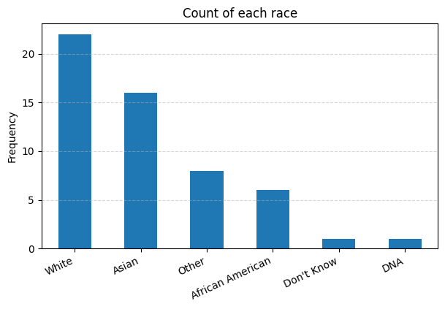
Sample population Demographics
General summary statistics that give us a good idea of who these people are and their living conditions:

Slide 15
Methods and Results
Methods for Each Objective
Results for Each Objective

Slide 16
Objective 1 Methods
Objective 1: Characterize resistance training behavior, and mental health, in a sample of men with symptoms of muscle dysmorphia.
The main goal of aim 1 was to show an overall data description in order to tell a story of the participants who are in the data set.
The method that was used to examine the statistics was a “.describe” command which provided the summary statistics for each of the columns in the data set.

Slide 17
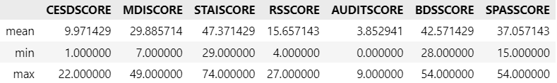
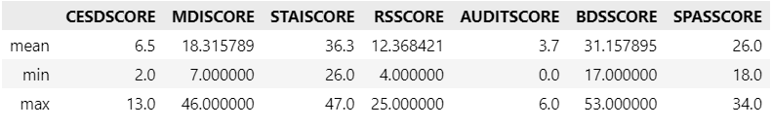
Objective 1 Results - Mental Health Scores
Individuals with Muscle Dysmorphia
Individuals without Muscle Dysmorphia

Slide 18
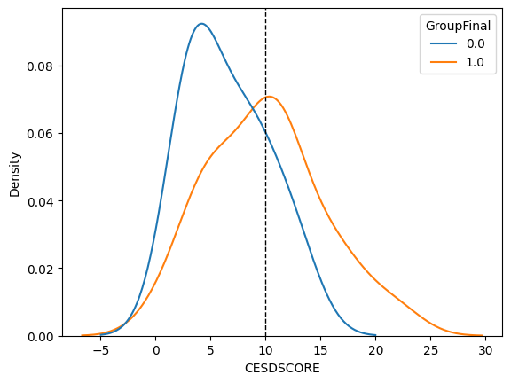
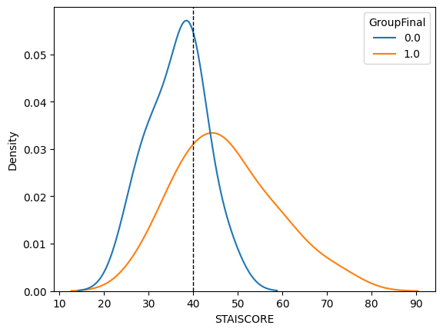
Objective 1 Results - Mental Health Scores
We can note that All mental health scores of people with muscle dysmorphia are higher than those without.

Slide 19
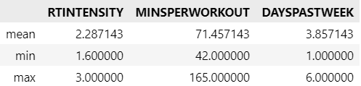
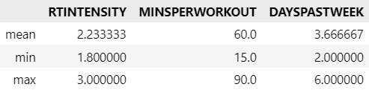
Objective 1 Results - Training Behaviors
Individuals with Muscle Dysmorphia
Individuals without Muscle Dysmorphia

Slide 20
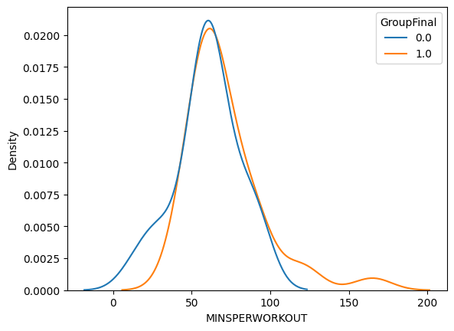
Objective 1 Results - Training Behaviors
People with Muscle Dysmorphia having similar training habits to people without Muscle Dysmorphia, excluding workout length.
The typical patient with muscle dysmorphia workout 3.85 days a week, for 71.45 minutes per session, at an intensity of roughly 2.28/3.

Slide 21
Objective 2 – Further Preprocessing
Objective 2: Explore whether a worse mental health, including symptoms of muscle dysmorphia, are associated with more frequent and intense resistance training behaviors.
Further preprocessing required (Switched to R)
Dropped all columns except ones involving training and mental health.
Then PCA was used on each of the seven surveys:
MDI, RS, BDS, SPAS, CESD, STAI, AUDIT.
After, the reduced dimensions were added back with the training variables.
Notes:
training: “days per week”, “intensity”, and “duration”

Slide 22
Objective 2 – Methods
Linear Regression Model
Intensity as the response variable.
Statistically significant dimensions from the PCA’s as the explanatory variables.
Forward Stepwise Regression
Intensity as the response variable
All the dimensions to see if a better outcome would be achieved.
Regression Tree Model
Predictive models to see if there is a direct correlation between variables.
Notes:
training: “days per week”, “intensity”, and “duration”

Slide 23
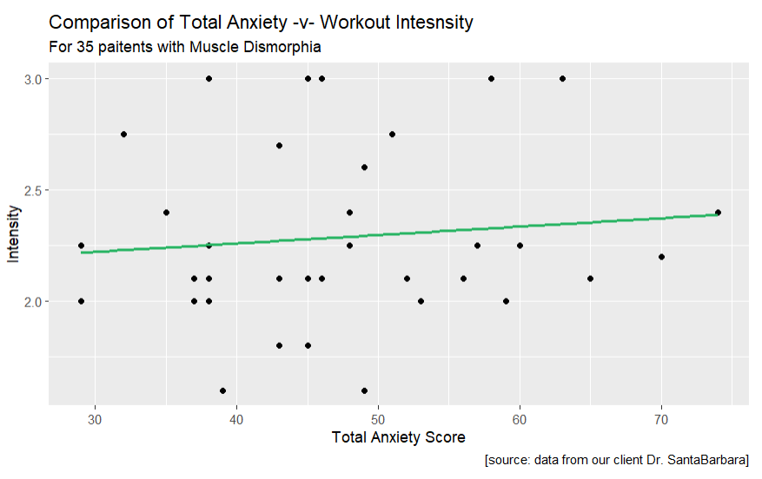

Objective 2 – Results
Basic Linear Regression Model
Using Total Scores
Low Correlation
Notes:
The forward stepwise regression table is alot stronger, almost doubling the R^2 value.
This model shows an accuracy of 47% and has some significant variables included in the model.

Slide 24
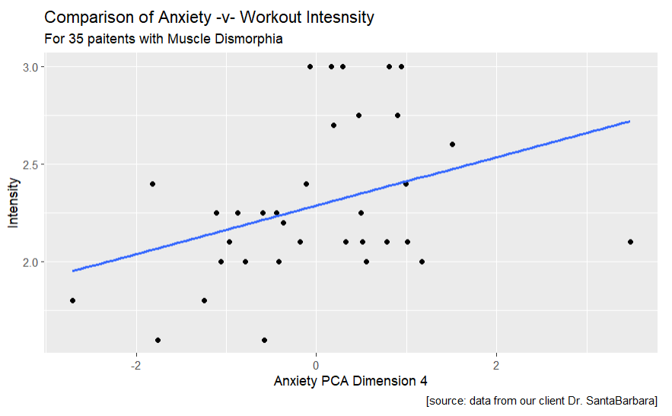
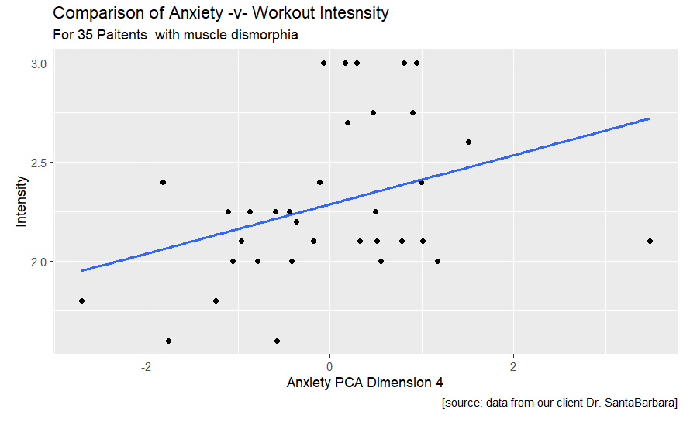
Objective 2 – Results
Preformed PCA to reduce dimensions
Found these significant variables:
MDI.Dim.2
RS.Dim.4
STAI.Dim.4
Most used question in STAI.Dim.4 –STAI 8
Notes:
Looking at the Pr(>|t|) column the dimensions lose significance when the other dimensions are not included.
The adjusted R^2 value is 0.21 or an accuracy of 21%, which is not accurate.
The forward stepwise regression table is alot stronger, almost doubling the R^2 value.
This model shows an accuracy of 47% and has some significant variables included in the model.

Slide 25
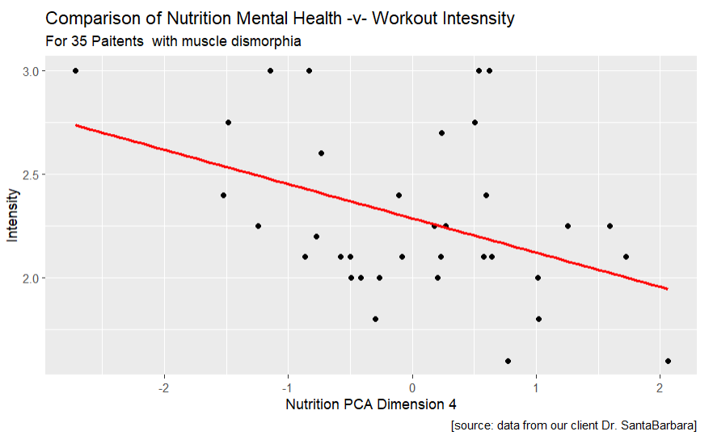
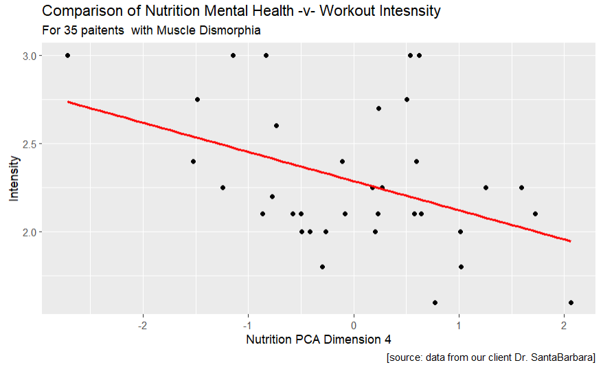
Objective 2 – Results
Forward Stepwise Regression to get the best variables
Found these significant variables:
RS.Dim.4
MinsPerWork
SPAS.Dim.3
STAI.Dim.5
STAI.Dim.4
STAI.Dim.2
Most used question in STAI.Dim.4 – RS10
Notes:
Looking at the Pr(>|t|) column the dimensions lose significance when the other dimensions are not included.
The adjusted R^2 value is 0.21 or an accuracy of 21%, which is not accurate.
The forward stepwise regression table is alot stronger, almost doubling the R^2 value.
This model shows an accuracy of 47% and has some significant variables included in the model.

Slide 26
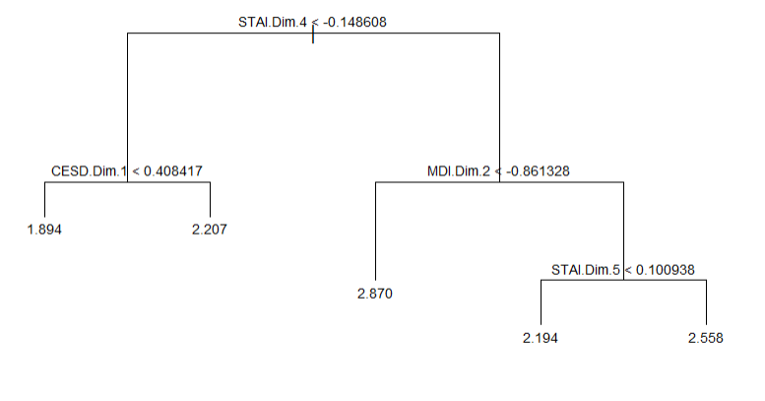
Objective 2 – Results
Regression Tree
Looks at data in a similar way but not linearly
Numbers at the bottom is the perceived Intensity
Notes:
Looking at the Pr(>|t|) column the dimensions lose significance when the other dimensions are not included.
The adjusted R^2 value is 0.21 or an accuracy of 21%, which is not accurate.
The forward stepwise regression table is alot stronger, almost doubling the R^2 value.
This model shows an accuracy of 47% and has some significant variables included in the model.

Slide 27
Objective 2 – Conclusion
Over all, these results show that the intensity of the workout is not associated with worse mental health, or having symptoms of muscle dysmorphia.
 | Linear on Scores | Linear on PCA | Forward Stepwise | Regression Tree
R^2 | 0.1363 | 0.2141 | 0.4712 | NA
Mean^2 Error | 0.3748 | 0.3534 | 0.2899 | 0.0543

Slide 28
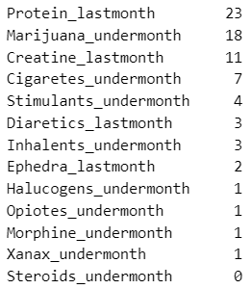
Objective 3 Preprocessing
Objective 3: Explore any associations between mental health and substance and supplement use.
Features that are far away from a 50/50 split (17/18 of the 35), will not return any significant results as predicting the mental health score of say 3 people is not reliable.
From here, I aimed to focus my model building around the first 5 features.

Slide 29
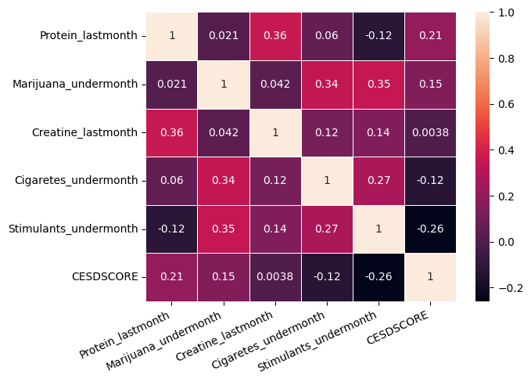
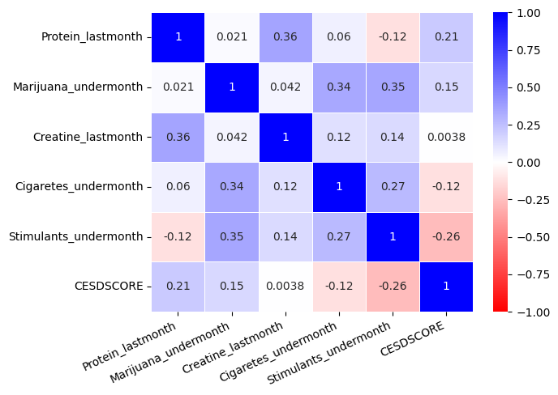
Objective 3 Early Analysis
Looking at correlations between the variables expected to be used in the models, it is notable to see that many correlations are not strong.
This can be a strong indication that model results will struggle.

Slide 30
Objective 3 Methods
Due to the nature of our data, ANOVA regression was the most fitting type of model to use when predicting a mental health score. As many of the substance and supplement use features were categorized as use within the month or use outside of the last month. While the mental health scores were on a numerical scale.
In one case, logistic regression wa able to be used since the mental health scale “CESD” has a medical cutoff at 10, where 10 is considered as displaying symptoms of depression. Thus, we can use logistic regression to predict if they pass this cutoff.

Slide 31
Objective 3 Results
Throughout the various ANOVA models testing CESD score, STAI score, MDI score, and other measures of mental health, none revealed any significant results, typically having R-Squared values around .3 and lower.
R-squared values that low tell us that these substance and supplement features are not good predictors for the mental health indexes.
The logistic regression model predicting CESD Status was also quite unsuccessful returning an R² value of 0.08. Showing that running it as a binary predictor did not work.

Slide 32
Objective 3 Results
 | ANOVA |  |  |  |  |  |  | Logistic Regression
MH Inventory | CESD | STAI | MDI | RS | BDS | SPAS | AUDIT | CESD - Status | STAI - Status
R^2 | 0.180 | 0.208 | 0.099 | 0.163 | 0.294 | 0.189 | 0.326 | 0.082 | 0.121
AIC | 219 | 270 | 266 | 228 | 237 | 262 | 154 | N/A | N/A
AUDIT index performs the best at both metrics.

Slide 33
Conclusions
Overall Conclusions
Acknowledgements

Slide 34
Conclusions
Throughout our objectives, we have seen that results have typically shown to not be statistically significant.
This does not mean that in a larger population of people that these connections between training behaviors, substance use, and mental health do not exist.
These results tell us that our sample did not have meaningful connections.
Statistical significance can be very difficult to find in datasets of small numbers.

Slide 35
Acknowledgements
Our Client Dr. SantaBarbara.
Our Professor Dr. St. Hilaire.

Slide 36
Thank you!
Questions?

